Slide 1
Summit features
ECP Annual Meeting, Houston, TX February 2020
Hong-Jun Yoon Computer Sciences and Engineering Division
Oak Ridge National Laboratory
yoonh@ornl.gov
www.ExascaleProject.org

Slide 2
Talk Outline
Job submission
Development environments
NVIDIA V100 GPU
Large Model Support

Slide 3
IBM Job Step Manager (JSM)
Job launcher for Summit: “jsrun” command
Resource set: “--nrs” or “-n”
Number of MPI tasks: “--tasks_per_rs” or “-a”
Number of CPUs: “--cpu_per_rs” or “-c”
Number of GPUs: “--gpu_per_rs” or “-g”
Binding of tasks within a resource set: “--bind” or “-b”
Example
Initiate 48 processes, assign 1 GPU, 7 CPU cores per process
jsrun -n48 -a1 -g1 -c7 python myscript.py
Running Horovod data parallel with 16 nodes
jsrun -n16 -a1 -g6 -c42 python happy_horovod.py

Slide 4
CANDLE/Supervisor/Summit: NVM
Using NVM as a data preprocessing workspace
Copy data to /mnt/bb once per workflow node
Benefits:
Reuse local copy for subsequent training cycles with different data subsets
Faster random access for data subsetting
Typical data rate ~1.3 GB/s for each of 128 nodes
Turns data preprocessing from I/O problem to CPU problem

Slide 5
CANDLE/Supervisor/Summit: LSF & JSRUN
Added support for LSF for Swift/T (new!)
Support script modification via environment variables that inject macros into the generated LSF script
Setting TURBINE_LAUNCH_OPTIONS="-g6 -c42 -a1 -b packed:42"
Sets JSRUN to use all 6 GPUs, 42 bound threads
Other scheduler features are abstracted by Swift/T and thus common across Summit, Theta, Cori, and cluster systems (e.g., NIH Biowulf).

Slide 6
IBM Watson Machine Learning Community Edition
To access IBM WML CE
module load ibm-wml-ce
For custom eivnronment: clone it!
$ conda create --name cloned_env --clone ibm-wml-ce-1.6.2-X
Support popular DL platforms
Distributed Deep Learning
Automatically distribute the job across
ddlrun python mygreatcode.py

Slide 7
NVIDIA V100 GPU
In the GPU
80 Streaming Multiprocessors
16 GB HBM2, 900 GB/s
6MB L2 cache
8 512-bit memory controllers
In each SM
32 FP64 cores
64 FP32 cores
64 Int32 cores
96KB L1 cache
TensorCores

Slide 8
TensorFlow Large Model Support
GPU memory is limited!
Way to utilize CPU memory?
IBM TensorFlow Large Model Support
https://developer.ibm.com/linuxonpower/2019/06/11/tensorflow-large-model-support-resources/
Swap In/Out Tensors
900 GB/s (HBM2) vs. 25 GB/s (NVLink)
Parameters to adjust swap in/out rates
Auto-tuned!

Slide 9
Code Snippet
from tensorflow_large_model_support import LMSKerasCallaback
…
lms = LMSKerasCallback()
…
callbacks.append( lms )

Slide 10
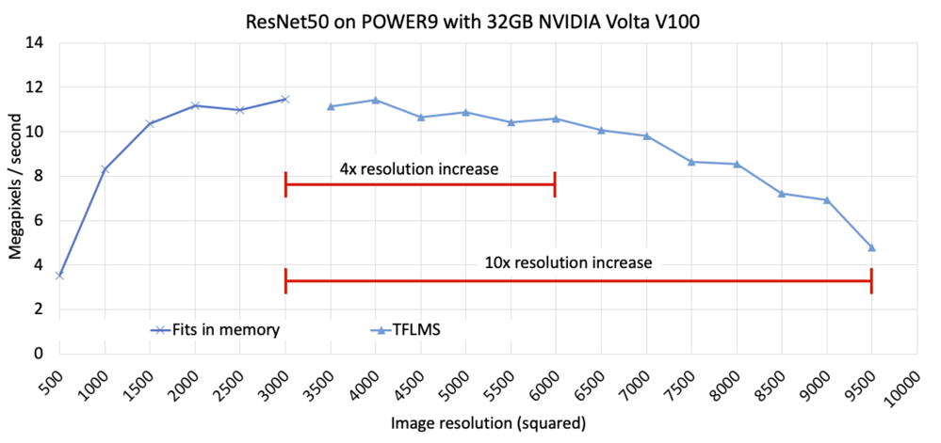
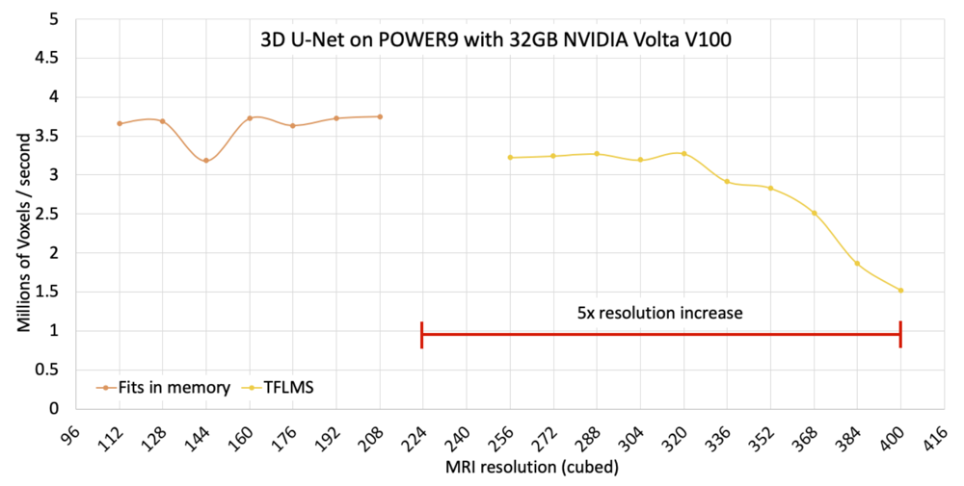

Performance
https://developer.ibm.com/linuxpower/2019/05/17/performance-results-with-tensorflow-large-model-support-v2/

Slide 11
Acknowledgments
This research was supported by the Exascale Computing Project (ECP), Project Number: 17-SC-20-SC, a collaborative effort of two DOE organizations - the Office of Science and the National Nuclear Security Administration, responsible for the planning and preparation of a capable exascale ecosystem, including software, applications, hardware, advanced system engineering and early testbed platforms, to support the nation's exascale computing imperative.
www.ExascaleProject.org

